Slide 1
The Way Forward for Chinese Manufacturers in to the Indian Security & Fire Systems Market
GB Singh
Publisher & Editor

Slide 3
Some historical facts about India
History: 5000 years old civilization
Land Area: 3.29 million square kilometers
Coastline : 7516 Km
It is the Seventh-Largest country by area and second-largest by population and most populous democracy in the world. 35% of the total population is aged under 15 years.
Government: Democratic, Parliamentary
Political System: India is a republic with a federal structure, comprising 29 States and 6 Union Territories.
Languages Spoken: Multilingual society with 14 principal languages. 38% speak Hindi. English is the preferred business language
Economy: After registering a growth of over 9% in 2010-11, it has slowed to about 5%. But still India is considered a promising business destination.

Slide 4
New International Economic Order
Economic Reforms: The reforms launched in early 90’s have made India an attractive place for investment. Custom Duties have been lowered, repatriation of profit made liberal and levels of foreign equity raised considerably, 100 percent in case of EOUs. Foreign Exchange reserves rose from $2B to 300B
Destination India: India had emerged as an across the board low cost base, attractive enough to multinationals to relocate in the country. A majority of Fortune 500 companies have a presence in India. However, viewing the uncertain economic environment globally, Foreign Direct Investment (FDI) in India slowed down by 33% in 2012 as compared to 2011*
New Policy Initiatives: Government initiatives in specific sectors such as Telecom, Ports, Airports, Railways, Roads, Energy and Construction Development have improved competitiveness of the Indian economy.
Nuclear Energy sector would be the big thing of tomorrow apart from Defense and Homeland Security markets.
The new National Policy for Electronics 2012
Source: Department of Industrial Policy & Promotion

Slide 5
National Policy for Electronics 2012
The Electronics Industry was worth US$ 45b in 2008-09 with domestic production being just US$ 20b, with local value addition being between 5-10% only.
Considering the present consumption and the estimated growth rate it will be about US$ 400b by the year 2020!
Considering the current rate of local manufacturing this is expected to scale up to US$ 100b or just 25% of the total demand.
Therefore the imports are expected to be about US$ 300b !

Slide 6
Security Industry
Electronic Systems (Alarms-CCTV-Access Control, EAS etc)
Physical Security (Fences, Safes, Locking hardware etc.)
Cash-in-Transit
Information Security
Risk Management (Consultancy, Surveys)
Manned Guarding Services
Investigations

Slide 7
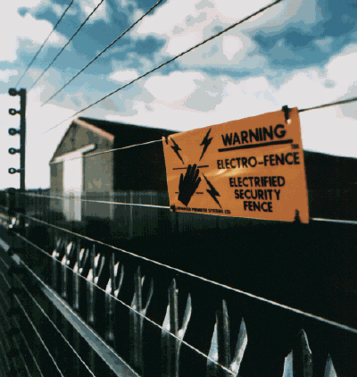
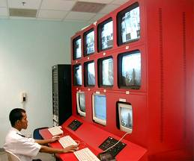
Security Systems Sector
Early Players - Bank Alarm Manufacturers & Installers
The mid 80’s - emergence of System Integrators. Trend accelerated in the 90’s.
Manufacturer – Importers – Installers & more lately, Distributors
Low level of manufacturing – Industry remains largely import based

Slide 8
Additional Information
The Indian market for security equipment is separated into the electronic sector and non-electronic sectors and organized and informal sectors.
The total number of players in the organized electronic sector is around 700 and unorganized sector accounts for 15,000 units.
Many Indian companies have collaborated with foreign manufacturers and are marketing foreign products in India.
Some manufacturing has recently started taking place. Security Systems Software development has been done in India since many years
Security equipment is imported mainly from: USA, U.K., Italy, Germany, Singapore, Hong Kong, Israel, Japan, Korea, China, New Zealand and Taiwan.

Slide 9
The CCTV Market
The Indian market for CCTV was estimated to be worth US$185.7 million in 2011 and is forecast to be worth US$5463 million in 2016
The Indian market for network video surveillance equipment was estimated to have been worth US$37.4 million and is forecast to grow to US$ 223.8 million, a CAGR of 43%
The commercial sector was estimated to be the largest in 2011. It was followed by retail, banking & finance and government (note that the government does not include government owned airports, educational facilities, hospitals, ports and railways, since these are covered in separate categories.
The fastest growing end-user industry is forecast to be city surveillance, which is forecast to grow from $5.6 million to $50 million from 2011 5o 2016
Source IMS Research
Source IMS Research

Slide 10
Electronic Security Systems Industry
Product Sector | Proportion | Market Size in US$ (Millions) | Expected Annual Growth
CCTV (Commercial & Industrial Cameras, Housings, Monitors, DVR/NVR's) | 55% | 275 | 40%
Access Control (Controllers, Readers, Locking Hardware, Barriers, Cards) | 24% | 120 | 25%
Intrusion Detection (Perimeter & Building Alarm Controllers & Detectors. | 2% | 10 | 20%
Door Intercom (Audio & Video) | 2% | 10 | 30%
Others (Metal Detectors, X-Ray etc) | 17% | 85 | 30%
TOTAL |  | 500 | 24%
Source SECURITY TODAY
Not Counting Police & Defense Supplies

Slide 11
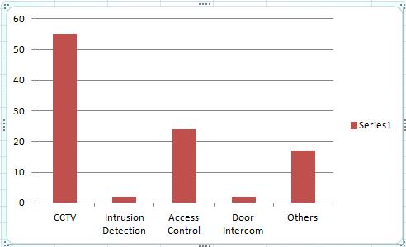
Indian ESS Market

Slide 12
Growth Impediments
Absence of Security Systems Standards
Low level of local manufacturing
Poor installation & after-sales-service support
Undervalued Imports and the active ‘Grey Market’.
The depreciating rupee has made imports expensive

Slide 13
Growth Drivers – The Way Forward
Increasing crime rates
Difference between the ‘Haves & Have nots’
Low faith in the law enforcement forces
Low Conviction Rate
Rise in general education & awareness
Rise in income levels & consumer spending
Legislation
Terrorism & Insurgency - (Homeland Security Market)
Increased Government allocations for Police Modernisation & Defense System Upgrades
Critical Infrastructure, Commercial Buildings, Nuclear Sector
Developments in the India Region (Pakistan, Afghanistan)

Slide 14
Homeland Security Market
The Assocham-KPMG report of 2010 predicts that by 2020, India, along with Britain, Germany and France, might outgrow the United States, which presently enjoys a 34% of the market share in this field.
India, which currently shares 3.6% of global homeland expenditure, will require to take it upwards to 6% over the 10 years to effectively take on emerging security risks.

Slide 15
Current & Future Trends
Physical Security Systems Sector
Trend towards one-stop shopping in the commercial and industrial markets as customers seek to decrease their systems integration costs
Move from Analog to Digital. IP Based systems gaining ground. Large companies increasing awareness
Convergence of IT & Physical Security
Arrival of IT Network & Communications players into the security systems arena (Cisco, D-Link, Tulip, HCL, TCS, WIPRO, Reliance etc)
Intelligent Facility Management Systems
City surveillance projects – Safe Megacity Programs

Slide 16
Pomising Growth Areas
Physical Security Services Sector
Residential Security & Home Automation Systems: (NCAER’s Macro Consumer Research says that by 2015-16, India will be a country of 53.3 million middle class households, translating into 267 million people falling in the category).
Biometrics – T&A, Access Control
Monitoring Services
City Surveillance
Homeland Security (Police Modernisation)
Video Management Software Development

Slide 17
Market Observations
Economic & Government
Emergence of Security Industry Publications
More Exhibitions & Seminars.
Industry Associations getting active. (FSAI, ASIS, CII, FICCI, ASSOCHAM)
Modernisation of Police Forces
Increased Border (Coastal) Surveillance & Controls
Government Initiatives: NatGRID, UID, CCTNS - 14,000 police stations and 6,000 other police offices by 2013. Automated Multimodal Biometric Identification System (AMBIS)

Slide 18
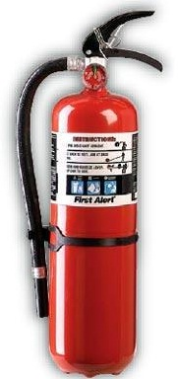
Fire Industry
Fire detection systems- Conventional and addressable fire alarm systems and aspiration detection
Firefighting systems- Hydrant systems, fire extinguishers and fire hoses with cabinets and reels.
Fire protection systems- Sprinkler systems, deluge systems and foam systems
Fire Suppression Systems- Inert Gas & CO2 Systems Novec 1230 & FM200 Systems and water mist Systems,
Notification Systems – Voice Alarm Systems, PA etc
Specialized Fire Fighting Systems

Slide 19
Fire Industry
Global estimated market size is approximately US$58 billion and expected to grow to around $73 billion by 2015
There are more than 15,000 companies worldwide in the fire protection business of which 5,000 are relevant with around 200 leading companies
With no authentic data available the Indian Fire Industry in India is estimated to be around Rs. 3400 crores
Currently, there are more than 60 companies with pan India presence, and a couple of thousand small players
Source Buildotech Magazine

Slide 20
IGIA T3 Terminal
5.2 million sq ft with annual capacity of 34 million passengers
85000 Sprinklers
75 Extinguishing Systems
54 low pressure – fine spray sprinkler systems
550 interior and exterior hydrants
10,600 water, powder, foam and CO2 extinguishers
34000 fire alarms connected to a total of 163 fire detection control panels
3000 security cameras

Slide 21
Top Fire Industry Trends
Multi Technology Detection: Combining up to four sensing technologies – regular photoelectric smoke sensor, light sensor, heat sensor and carbon monoxide sensor.
Integration: Fire detection systems can be integrated to other systems in the building, such as Intrusion, CCTV, Access Control, IBAMS. A single software interface to manage buildings remotely.
Mass Notification: These services allow the users to create an alert and to initiate a notification broadcast, to numerous contacts, simultaneously on multiple devices including cell phones, tablets, email etc.
Voice Evacuation Systems getting popular
Source Frost & Sullivan Analysis

Slide 22
Top Fire Industry Trends
Shift from Conventional to Addressable Fire Alarm Systems
Suppression: Water Mist, Fluorinated Ketones, Powdered Aerosoles or Gelled Hydrocarbon/dry chemical suspension with ammonium polyphosphate have strong potential. These are at various stages of commercialization
Wireless Technology: This offers a high level of performance and reliability. Advantages are retrofitting older buildings. Certification, maintenance and cost issues are impediments in their growth.
Networked Systems: As most buildings today have a IP network in place, implementation and installation is easy.
Source Frost & Sullivan Analysis

Slide 23
Major Market Areas
- NORTH (Delhi, Haryana, Punjab, part Uttranchal & West UP, NE Rajasthan)
WEST (East Gujarat, Mumbai, Goa, Maharashtra)
SOUTH (Hyderabad, Bangalore, Chennai, Coimbatore, Mangalore, Trivandrum,)

Slide 24
The Way Forward
Standardization of design and customisation on a need basis
Customization of design must consider safety features; under no circumstances should safety features be diluted for commercial reasons.
Legislation must encourage the firefighting industry.
Greater enforcement of standards
Close working with the Fire Department to enhance the efficiency of service

Slide 25
The Way Forward
Specialist courses in engineering colleges for firefighting and detection
Strategic alliances among different stakeholders (global players tying up with local experts)
Greater thrust on mock drills / exercises
Increased awareness on “Disaster Response Planning”
Increased awareness on “Emergency Evacuation Procedures”.
Emphasis on training & Skill Development

Slide 26
Industry ‘Asks’ from the Government
At present Custom Duties are at par with Luxury White Goods Sector. Lowering of Basic Custom Duties to 0% or at least at par with IT and Telecom sectors
Incentivise usage of Fire & Security Protection Measures – Grant a higher rate of Depreciation
Standards for the security equipment
Rationalization of VAT
Protection Industry should be accorded the status of a ‘Priority Sector’ – Life Safety Equipment
Tax holiday of 10 years for indigenous manufacture

Slide 27
Way forward for Overseas (Chinese) Manufacturers
In the Short Term, the overseas manufacturers may tie up with a strong local distributor/s to sell imported products to system integrators.
In the Mid Term, the overseas manufacturer will have to set up a local workshop for after sales service of its products with efficient warranty repairs and after sales service
In the Long Term, in accordance with the new National Policy for Electronics, local manufacturing with significant value addition will have to be done
Opportunity to drive scales for best economy and globally become export competitive

Slide 28
Thank You

